Slide 1
Evaluating effect size distribution of different regenerative agriculture practices across soil, climatic and topographical factors
Update

Slide 2
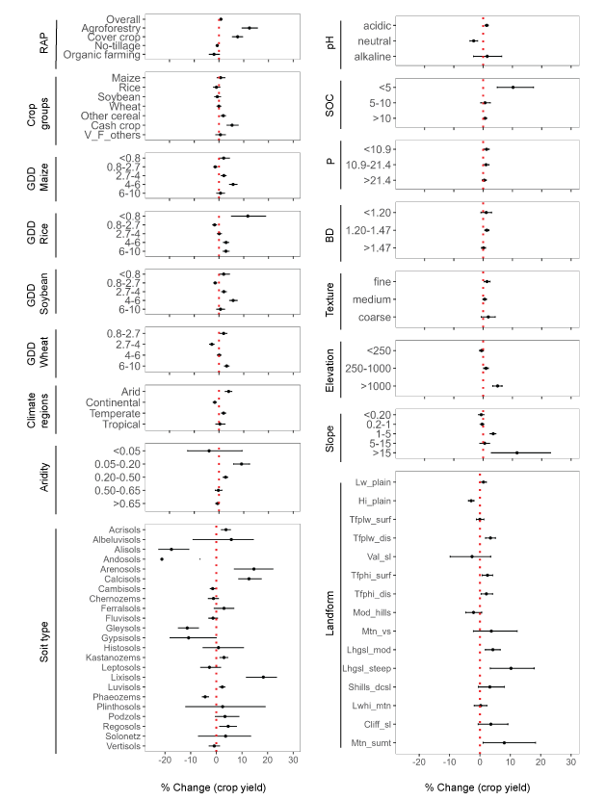
Results 1: Overall trend in data across all variables

Slide 3
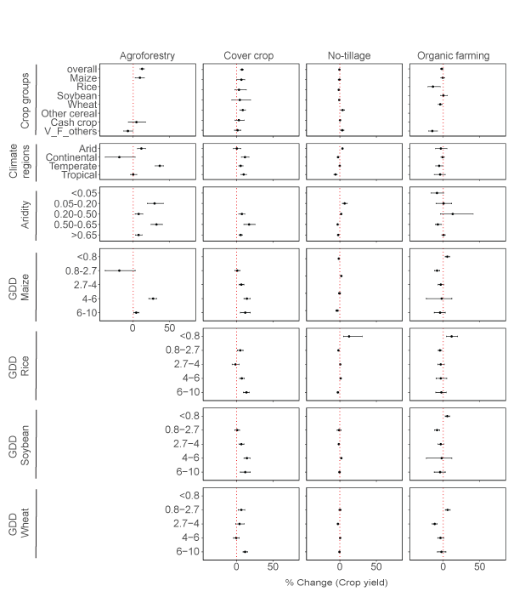
Results 2: Trend in data for each management and
across all variables
Crop groups
Climate regions
Aridity
GDD

Slide 4
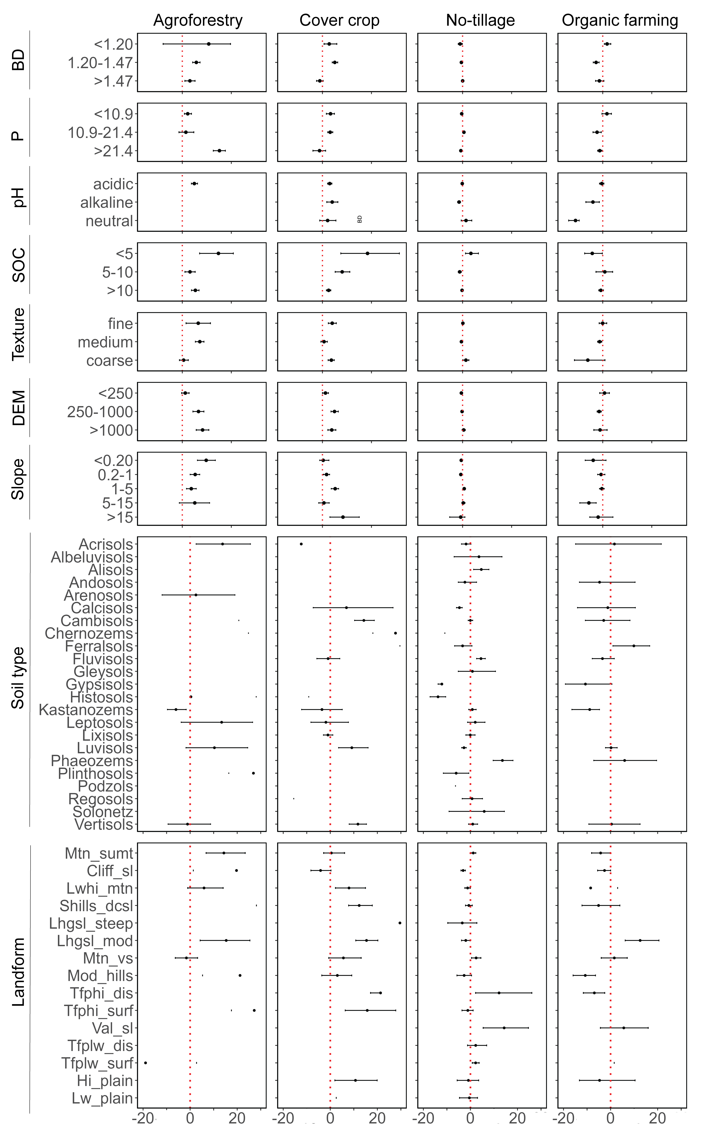
Results 2: Trend in data for each management and
across all variables
BD, P, pH, SOC
Texture
Elevation
Slope
Soil type
Landform
% change (crop yield)

Slide 5
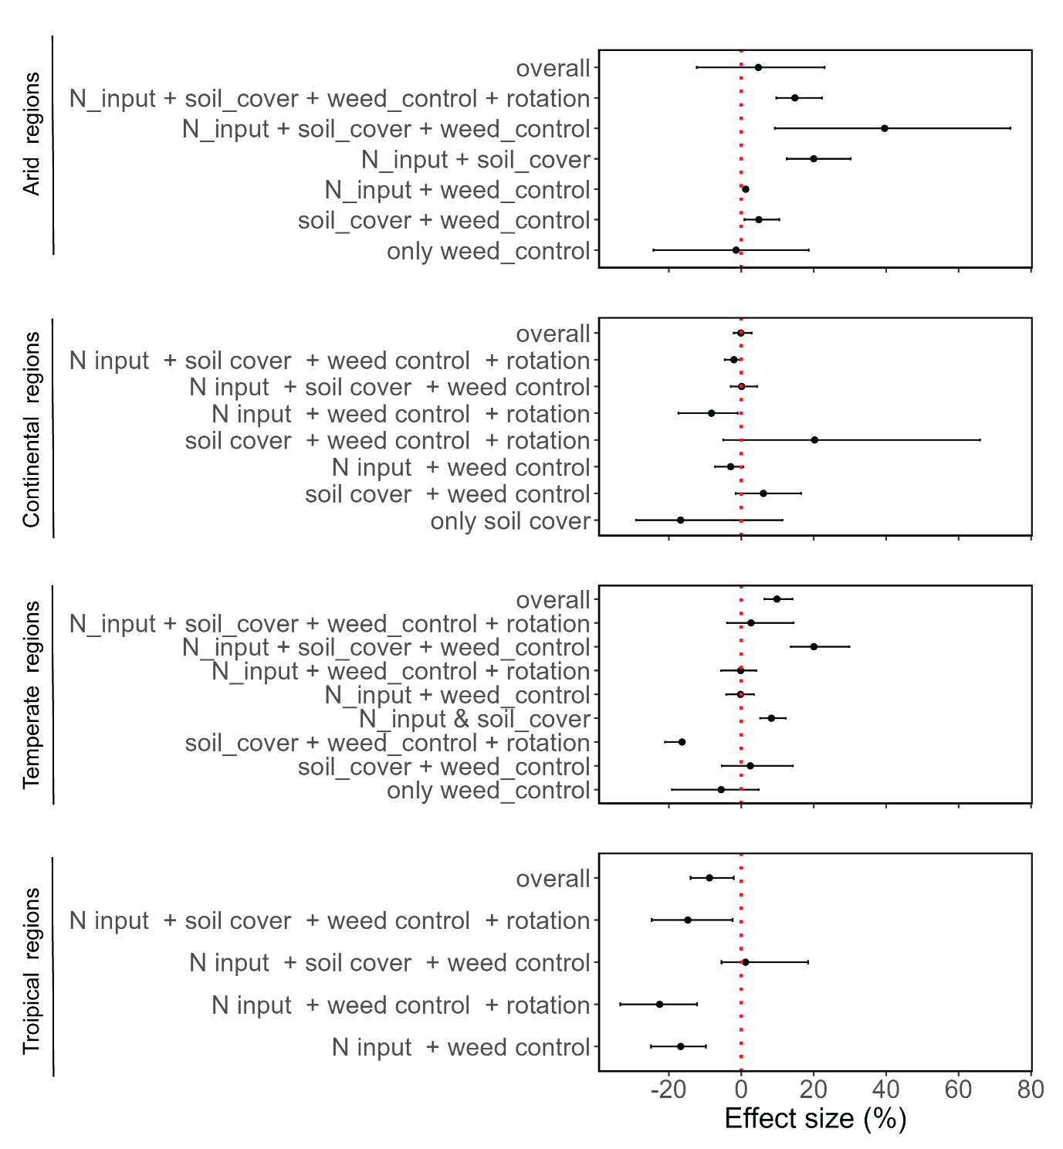
Results 3: Effect size distribution across different no-
tillage management practices
BD, P, pH, SOC
Texture
Elevation
Slope
Soil type
Landform
% change (crop yield)

Slide 6
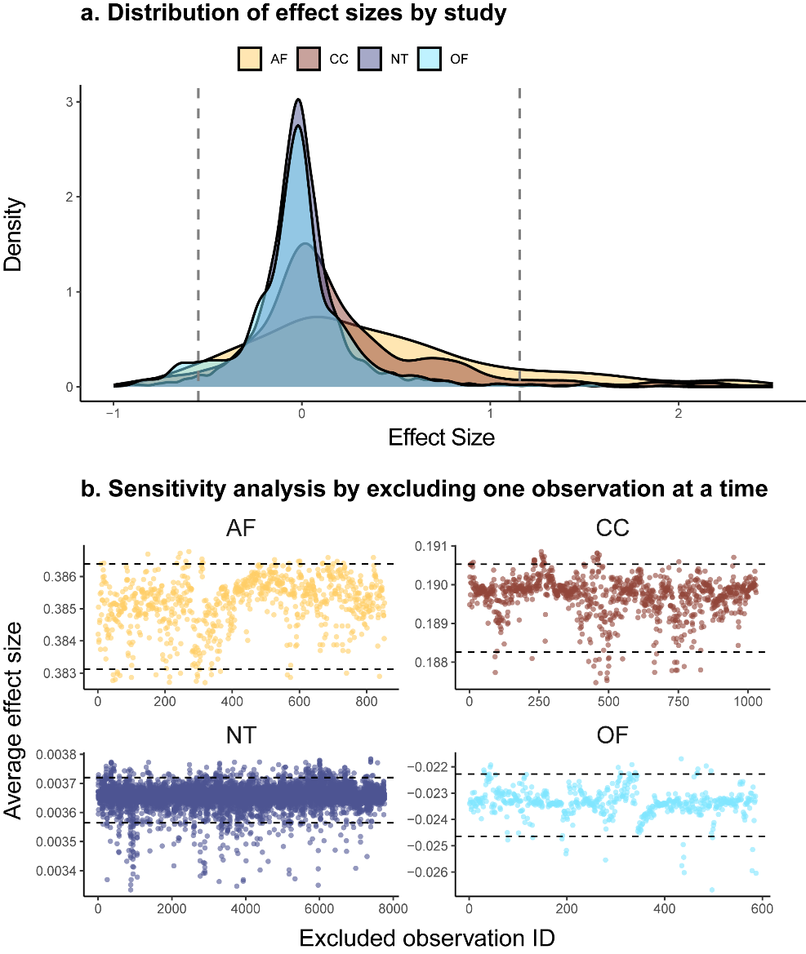
Results 4: Sensitivity analysis

Slide 7
Statistics???
Not repeat the first article

Slide 8
Discussing further the effect size distribution across variables by mapping
Select the best variables using XGBoost for prediction
Relation of the top 2 variables with effect size
Map => the bivariate trend

Slide 9
Agroforestry
XGBoost : R² = 0.21
Phosphorus, Aridity
Humid
>0.65
Sub-humid
0.50-0.65
Decreasing aridity
0.20-0.50
Semi arid
Arid
0.05-0.20
Hyper arid
< 0.05
Very Low
Low
Medium
high
Very high
<5
5-10
10-20
20-30
> 30
Phosphorus
Increasing environmental risk

Slide 10
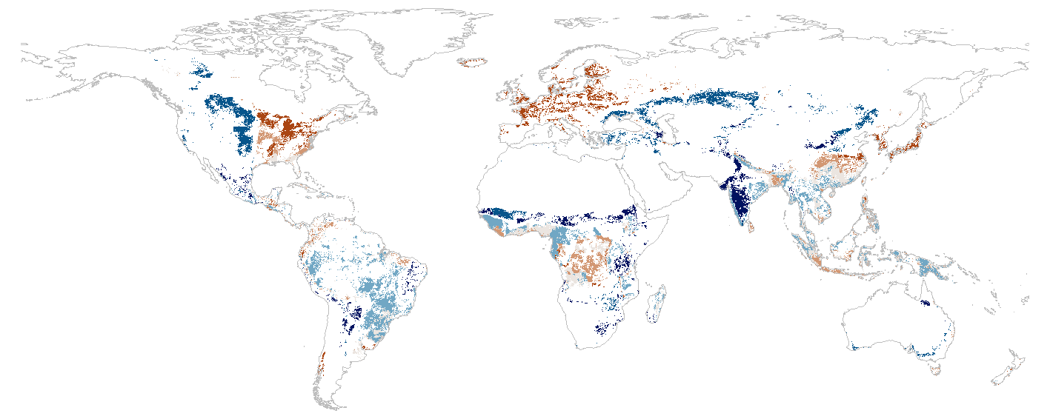
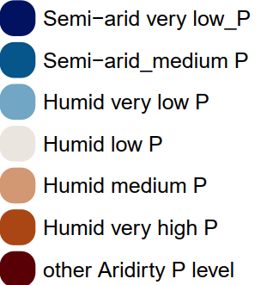
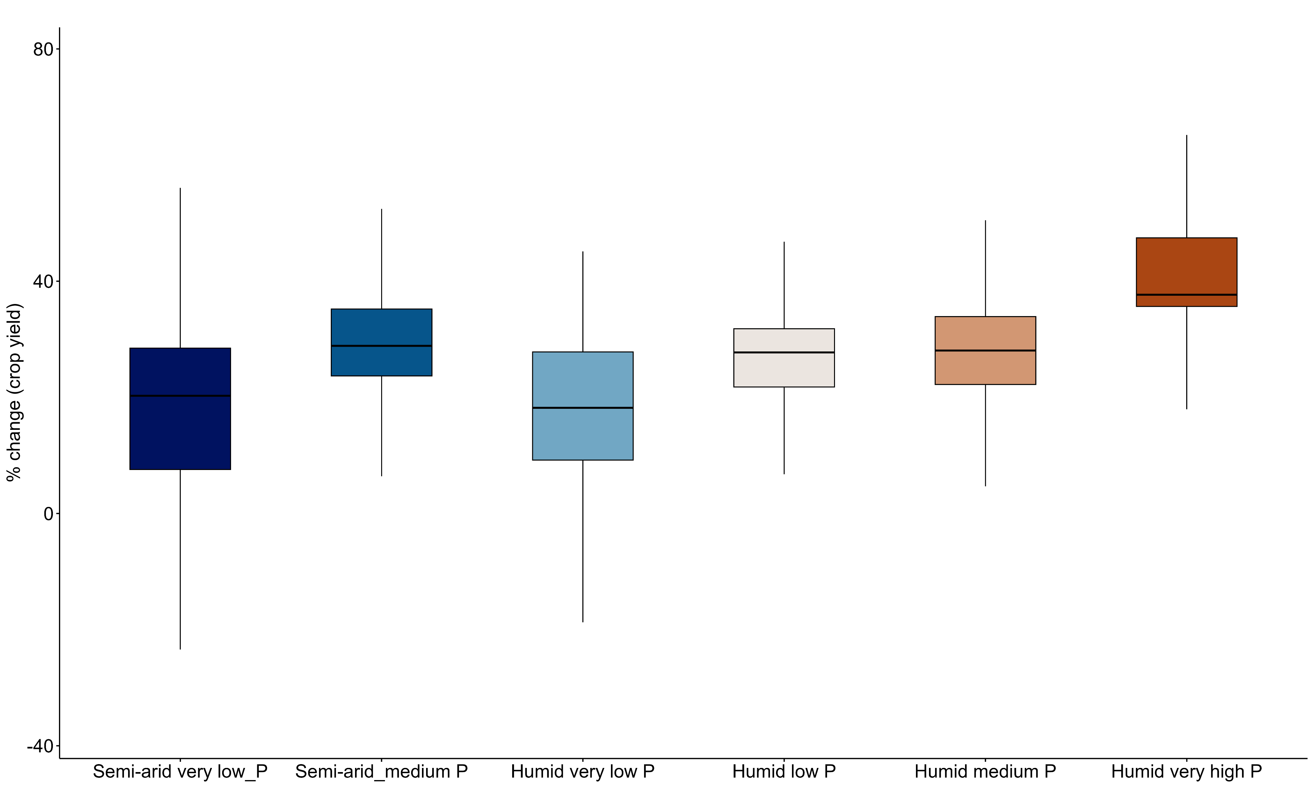
Effect size, Aridity, P

